Slide 1
Government Common & Model Apps
Packaging & Layering
Dynamics 365 Government Portal
PowerApps Portal
Government Model Apps
Government Processes
Government Connection Roles
Government Common CDM
Microsoft Dataverse
Government Specific Solutions
Existing Microsoft Business Applications Solutions

Slide 2
Government Common CDM -> Primary Entities
Entity Name
Application
Application type
Business Permit Application
Business Grant Application
Business License Application
External System
Grant
Housing Benefit Application
License
Permit
Program
Program Benefit
Program Eligibility Requirement
Program Participant
Dynamics 365 Government Portal
Power Apps Portal
Government Model Apps
Government Processes
Government Connection Roles
Government Common CDM
Microsoft Dataverse

Slide 3
Government Common CDM -> Primary Entities (continued)
Dynamics 365 Government Portal
Entity Name
Program Type
Public Policy
Service
Service Type
Service Recipient
Power Apps Portal
Government Model Apps
Government Processes
Government Connection Roles
Government Common CDM
Microsoft Dataverse

Slide 4
Government Common CDM -> Enriched Entities
Dynamics 365 Government Portal
Power Apps Portal
Government Model Apps
Government Processes
Entity Name | Source
Account | CDM Common
Connection | CDM Common
Contact | CDM Common
Government Connection Roles
Government Common CDM
Microsoft Dataverse

Slide 5
Government Connection Roles -> Primary Connection Roles
Connection Roles
Government Program
Government Service
Program Director
Program Manager
Program Coordinator
Service Manager
Service Deputy
Service Agent
Dynamics 365 Government Portal
Power Apps Portal
Government Model Apps
Government Processes
Government Connection Roles
Government Common CDM
Microsoft Dataverse

Slide 6
Government Processes -> Enriched Entities
Dynamics 365 Government Portal
Entity Name | Source
Application | Government Common CDM
Application type | Government Common CDM
Business License Application | Government Common CDM
Housing Benefit Application | Government Common CDM
Building Permit Application | Government Common CDM
Business Grant Application | Government Common CDM
Power Apps Portal
Government Model Apps
Government Processes
Government Connection Roles
Government Common CDM
Microsoft Dataverse

Slide 7
Government Model Apps -> Enriched Entities
Entity Name | Source
Account | Common CDM
Application | Government Common CDM
Grant | Government Common CDM
Program | Government Common CDM
Program Participant | Government Common CDM
Public Policy | Government Common CDM
Service | Government Common CDM
Service Recipient | Government Common CDM
Dynamics 365 Government Portal
Power Apps Portal
Government Model Apps
Government Processes
Government Connection Roles
Government Common CDM
Microsoft Dataverse

Slide 8
Government Model Apps -> Apps
Dynamics 365 Government Portal
App Name | Type
Government Services | Model-Driven
Power Apps Portal
Government Model Apps
Government Processes
Government Connection Roles
Government Common CDM
Microsoft Dataverse

Slide 9
Government Portal -> Enriched Entities
Entity Name | Source
Account | Common CDM
Application | Government Common CDM
Application type | Government Common CDM
Business License Application | Government Common CDM
Housing Benefit Application | Government Common CDM
Building Permit Application | Government Common CDM
Business Grant Application | Government Common CDM
Contact | Common CDM
Grant | Government Common CDM
License | Government Common CDM
Permit | Government Common CDM
Program Participant | Government Common CDM
Service Recipient | Government Common CDM
Dynamics 365 Government Portal
Power Apps Portal
Government Model Apps
Government Processes
Government Connection Roles
Government Common CDM
Microsoft Dataverse

Slide 10
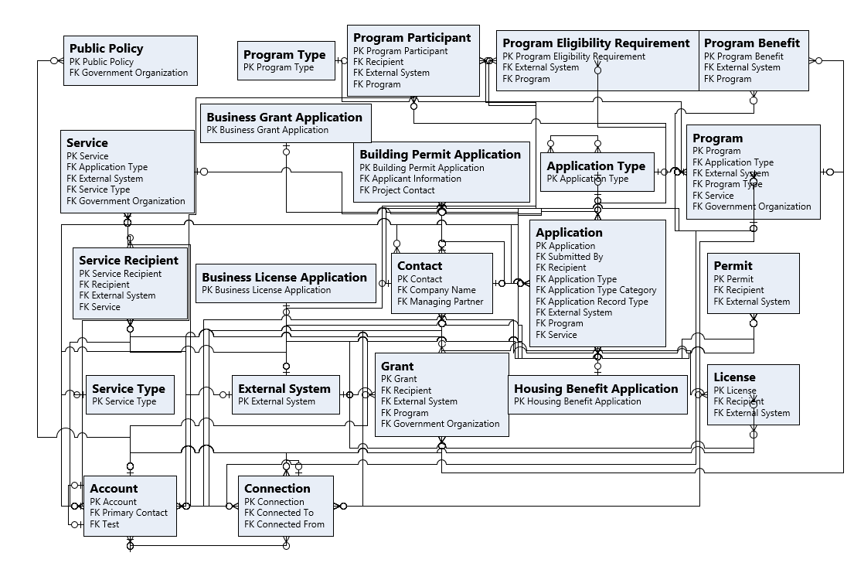
ERD : Government Common

